Slide 1
Synthetic Polymers and Their Properties

Slide 2
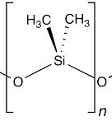
What is a polymer?
Example:
PDMS (polydimethylsiloxane)
Polymer- long, chainlike molecule composed of repeating monomer units
Organic polymers: DNA, RNA, proteins
Synthetic polymers: many types of plastics, silicones, Styrofoam, Teflon, Nylon, and more
Brackets indicate the monomer; n refers to a general number of repeating subunits.

Slide 3
General Properties of Synthetic Polymers
Each polymer has its own particular properties, but here are some common ones:
Tend to be durable- the longer the molecule, the greater attractive forces between molecules (so higher melting and boiling point)
Lightweight but strong
Good thermal and electrical insulators
Resistant to some chemicals

Slide 4
Everyday Examples of Polymers
Polyethylene water and soda bottles
Polyvinyl chloride hoses, pipes, and more
Polypropylene athletic fabrics
Teflon® coated nonstick cookware
Plastic wrap
Styrofoam cups

Slide 5
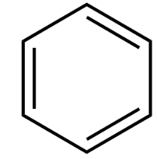
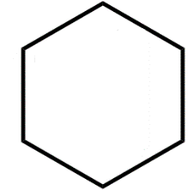
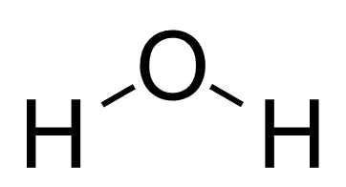
Solubility
Molecules with similar polarities will dissolve in one another
i.e. polar molecules dissolve in polar solvents, nonpolar molecules dissolve in nonpolar solvents
There are degrees of polarity- for example, water is more polar than isopropyl alcohol, but both are polar
Molecules with an H directly bonded to an F, O, or N tend to be the most polar
Water: “The Universal Solvent.” Extremely polar
Nonpolar Molecules
Nonpolar Molecules
Remember that molecules are polar when there is an asymmetrical distribution of charge, often due to lone pairs and polar bonds that do not cancel.
Benzene
Cyclohexane

Slide 6
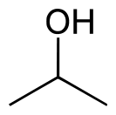
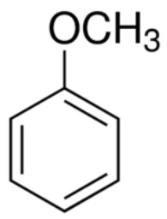
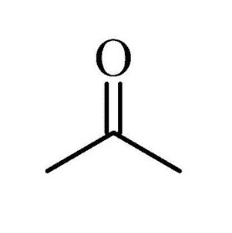
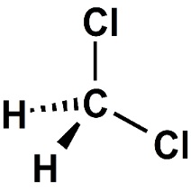
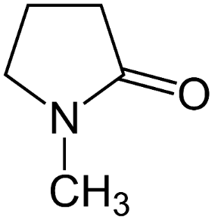
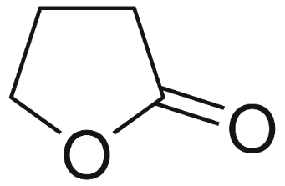
Some Common Solvents
Water: “The Universal Solvent”
Nonpolar Molecules
Benzene
Cyclohexane
Lower molecular weight → Usually more volatile (depending on polarity). Volatile compounds evaporate more easily than less volatile compounds.
IPA
dichloromethane
acetone
anisole
GBL
NMP
Halogenated solvent
Very volatile
Less polar and/or lower molecular weight
Moderate polarity and molecular weight
Notes:
Propane vs. Octane

Slide 7
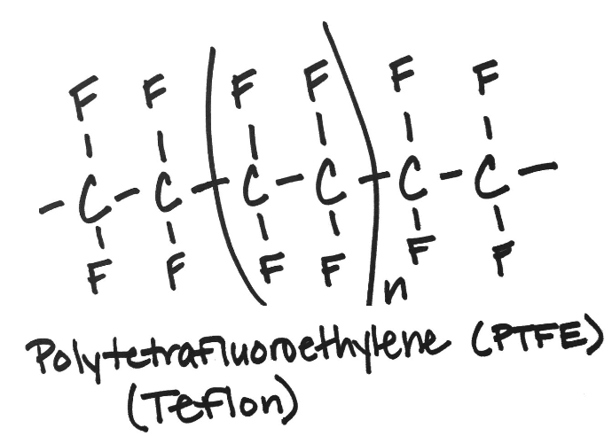
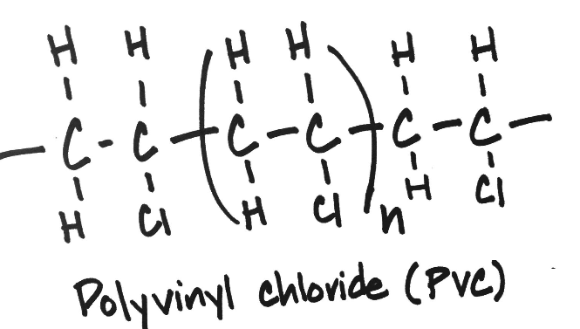
Apply Your Learning
The structures of two different polymers is given below.
Based on each polymer subunit,
which polymer would you expect to be more dense? Justify your answer.

Slide 8
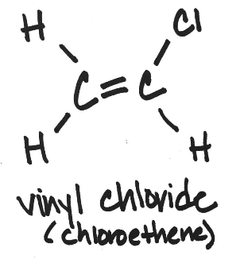
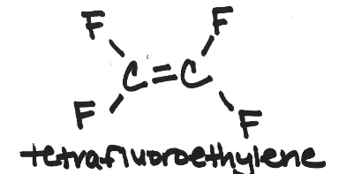
Apply Your Learning
The monomers used to synthesize the polymers above are given below.
Would you expect vinyl chloride or tetrafluoroethylene to be more soluble in water? Why?

Slide 9
References
[1] Fritz, N., Dao, H., Allen, S. A. B., & Kohl, P. A. (2012). Polycarbonates as temporary adhesives. International Journal of Adhesion and Adhesives, 38, 45-49.
[2] Li, H., Wu, J., Huang, X., Yin, Z., Liu, J., & Zhang, H. (2014). A universal, rapid method for clean transfer of nanostructures onto various substrates. ACS nano, 8(7), 6563-6570.
[3] Berger, M. (2014, July 8). A universal and rapid method for transferring nanostructures. Retrieved July 18, 2017, from http://www.nanowerk.com/spotlight/spotid=36430.php
[4] “Plastics.” The Basics: Polymer Definition and Properties, plastics.americanchemistry.com/plastics/The-Basics/.

Slide 10
This work, which includes teacher and student resources, is licensed under a Creative Commons Attribution-Noncommercial-Share Alike 3.0 UnportedLicense. To view a copy of this license, visit: http://creativecommons.org/licenses/by-nc-sa/3.0/. (Creative Commons — Attribution-NonCommercial-ShareAlike 3.0 Unported — CC BY-NC-SA 3.0) To attribute this work, please use: “J. Scimeca. Polymers Presentation (2018).”

